Slide 1
Project 3
Power Usage Simulation
Team 4

Slide 2
Class Association
Appliance
Regular Appliance
Smart Appliance
Main Class

Slide 3
Class Diagram Designs - Appliance
Appliance
Attributes:
int locationID;
String appName;
int onPower;
double probOn;
boolean appType;
double lowPower;
Accessors:
getLocationID()
GetAppName()
GetOnPower()
getProbOn()
getLowPower()
Mutators:
setLocationID(int locationID)
setAppName(String appName)
setOnPower(int onPower)
setProbOn(float probOn)
setLowPower(int lowPower)
Constructor:
Public Appliance(int locationID, String appName, int onPower, double probOn, boolean appType, double lowPower)

Slide 4
Class Diagram Designs - Regular
Regular
Attributes:
private boolean off;
private boolean on;
public boolean status;
Constructor:
public RegularAppliance(int locationID, String appName, int onPower, double probOn, boolean appType, double lowPower){
super(locationID, appName, onPower, probOn, appType, lowPower);
this.off = false;
this.on = true;
}
Method 1: turnOn
public boolean turnON()
{
on = true;
return on;
}
Purpose:
Changes boolean on to true when called upon, and returns the modified boolean.
Method 2: turnOff
public boolean turnOff()
{
off = true;
this.onPower = 0;
return off;
}
Purpose:
Uses boolean in order to determine if appliance is on or off, when off is true, power is established as 0. Then the status of appliance off is returned.

Slide 5
Class Diagram Designs - Smart
Smart
Attributes:
private boolean off;
private boolean on;
private boolean low;
public boolean status;
Constructor:
public SmartAppliance(int locationID, String appName, int onPower, double probOn, boolean appType, double lowPower)
Purpose: Declares values from attributes in the Smart Class and super class.
Method 1: turnOn
public boolean turnON()
{
on = true;
return on;
}
Purpose: Changes the boolean “on” to true.
Method 2: turnOff
public boolean turnOff()
{
off = true; this.onPower =0;
return off;
}
Purpose: Changes the boolean “off” to true and changes the power to 0.0
Method 3: turnLow
public void turnLow()
{
this.onPower = this.onPower - (int)this.getLowPower() * this.onPower;
}
Purpose: Changes the boolean “low” to true and changes the power to the specified power from the appliance information

Slide 6
Class Diagram Designs - Client Class
Client Class
Method 3/4: Add/Delete Appliance
The method utilizes input and ArrayList method .contains() to add/remove object
Method 5: ListAppliances
The method utilizes a for-loop to print the object elements.
public static double allowedPower;
public static String txtFile;
public static int timeSteps;
public static int turnedToLow;
public static ArrayList appliances;
Method 2: ReadAppFile
The method uses the File and Scanner class to read the input text file from the user
Method 6: Simulation
The method runs the full algorithm of the power usage simulation system.
After each timestep, the algorithm outputs the results.
Method 1: CreateArrayList
After reading the text file, the program creates an ArrayList of Regular and Smart Appliances.
Method 7: Main
The main method grasps the inputs from the user and stores them for further use in the simulation.
Next, it provides a user menu

Slide 7
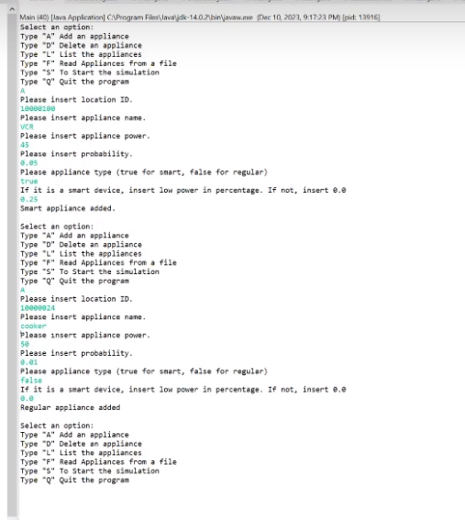
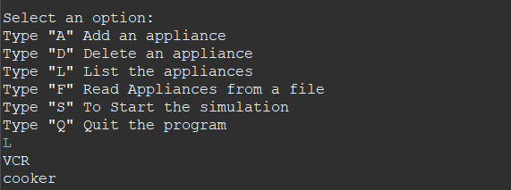
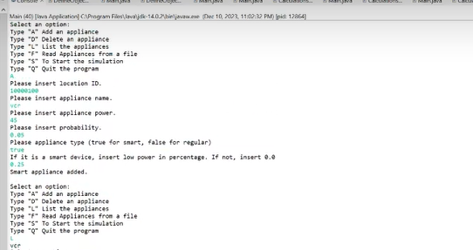
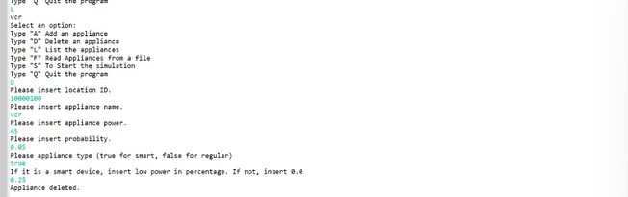
Test Cases
Added smart appliance: | Added regular appliance:
Added appliance instance: | Deleted appliance shown on newly updated list:

Slide 8
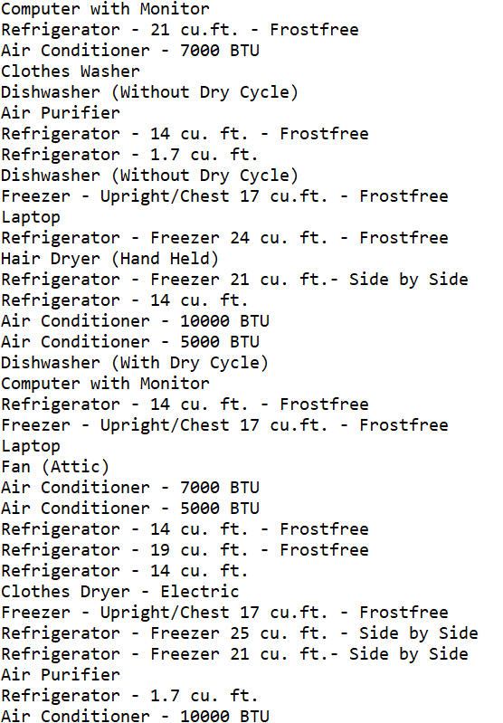
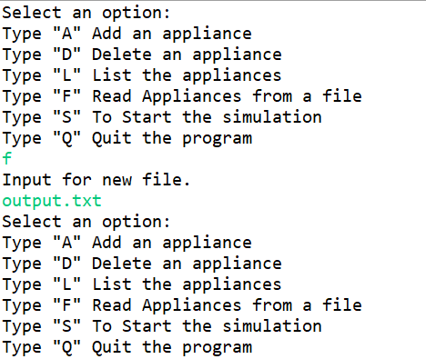
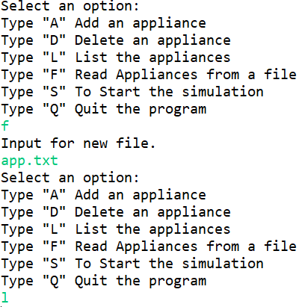
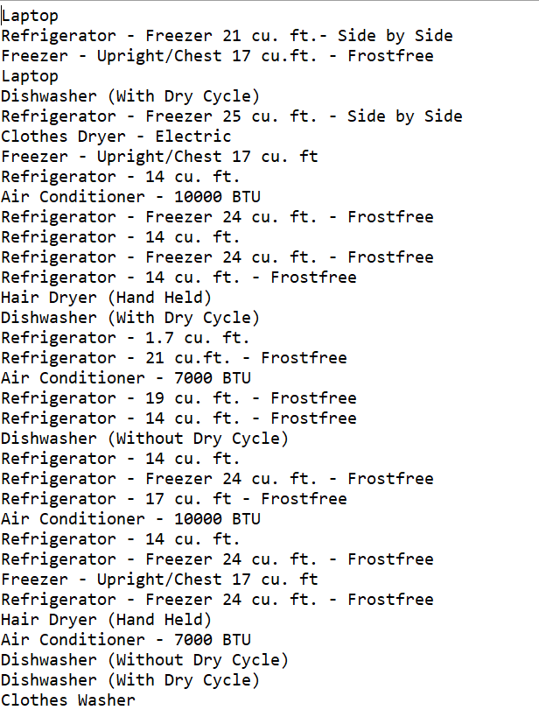

Slide 9
Algorithm Description
Inputs:
Add or Remove Appliances or Read from File :
Location ID
Appliance name
Appliance type (smart/regular)
Power usage
Probability of being OFF each timestep
Low power usage percentage (if applicable)
# of timesteps
2.) Array Creation
Turn inputted appliances into an Arraylist
Sort Smart Appliances in decreasing order based on power use
If current wattage is above maximum levels, use array order to gradually turn smart appliances to ‘low’ (assuming they aren’t already ‘low’) until either total wattage is acceptable or all smart appliances are on ‘low’
3.) Brown Outs
If all smart appliances are already set to ‘low’, ad the maximum wattage is not satisfied, begin brownouts
Choose location with the least amount of appliances present and apply brownout
Check wattage and if maximum is not satisfied, repeat

